Slide 1

ANALYSING HOTEL BOOKING DATASET
WHAT DRIVES BOOKING CANCELLATIONS
A PRESENTATION BY
AMS572 GROUP FIVE

Slide 2

I
Introduction
II
Methodology and Data Sources
TABLE OF
III
Exploratory Data Analysis
CONTENTS
IV
Hypothesis Tests
V
Factors Influencing Hotel Booking Cancellations
VI
Effects of Simulated Outliers On The Conclusions of the Hypothesis Test

Slide 3

INTRODUCTION
OVERVIEW OF HOTELS
PROBLEM STATEMENT
City Hotels: Located in urban areas, serves business and urban travelers, focus on convenience.
Resort Hotels: Situated in scenic or vacation destinations, focus on extended days and luxury
An increase in hotel booking cancellations have been observed, affecting revenue management and operational planning in the hospitality industry.
OVERVIEW OF BOOKING CANCELLATIONS
OBJECTIVE AND SIGNIFICANCE
The purpose of this analysis is to explore booking cancellations among the hotel types and find out which factors could predict a hotel booking cancellation.
A booking cancellation occurs when a guest reverses their hotel reservation before their planned stay. It differs from
No show
Amendment
Early checkout

Slide 4

METHODOLOGY AND DATA SOURCES
SOFTWARE
TOOLS
DATA
SOURCES
R was used for all statistical analysis.
PowerPoint was used for the presentation slides
Dataset was downloaded from Kaggle.
Data was already clean

Slide 5





EXPLORATORY DATA ANALYSIS
KEY INSIGHTS
81,503
The overall count of the current customer base within the analyzed period.
119,390
The combined total bookings recorded within the analyzed period, includes both City and Resort Hotel bookings.
Total Bookings
44,224
The number of customers who cancelled their reserved booking whether at a City Hotel or Resort Hotel.
Cancelled Bookings
37.04%
The rate at which customers cancel their reserved booking, usually measured in percentage terms.
Cancellation Rate

Slide 6
EXPLORATORY DATA ANALYSIS
CORRELATION ANALYSIS
TOP 5 VARIABLES WITH HIGHEST CORRELATION WITH BOOKING CANCELLATION
Variables | Correlation Coefficient | Coefficient of Determination
Lead time | 0.29312 | 0.08592
Previous cancellations | 0.11013 | 0.01213
Number of adults | 0.06002 | 0.00360
Days in waiting list | 0.05419 | 0.00294
Average Daily Rate | 0.04756 | 0.00226
Although some variables seem to have weak correlation with cancellation status, analysis could be made by considering the highly correlated variables to booking cancellation

Slide 7
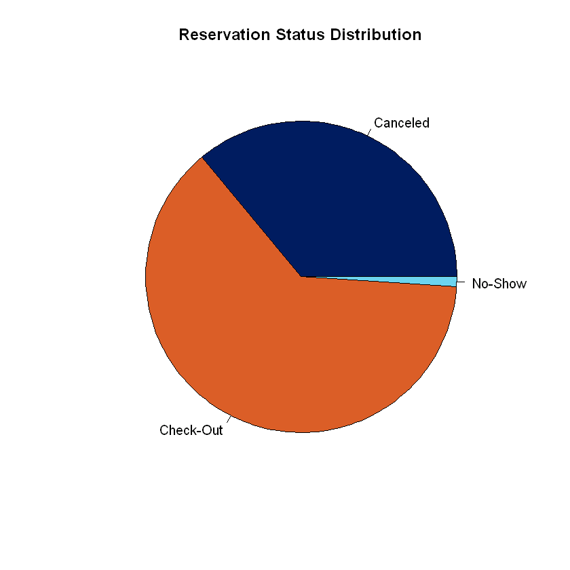
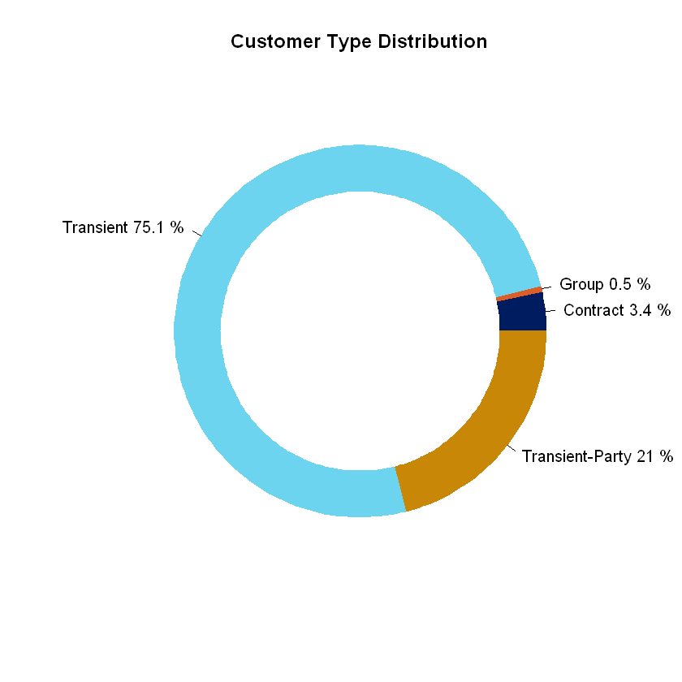
EXPLORATORY DATA ANALYSIS
CUSTOMER DISTRIBUTIONS
A visual breakdown depicting the proportions of bookings in terms of cancelations, not showing up and checking out.
Visualizing the distribution of customers by the type of booking they made; whether single, group or contract.

Slide 8
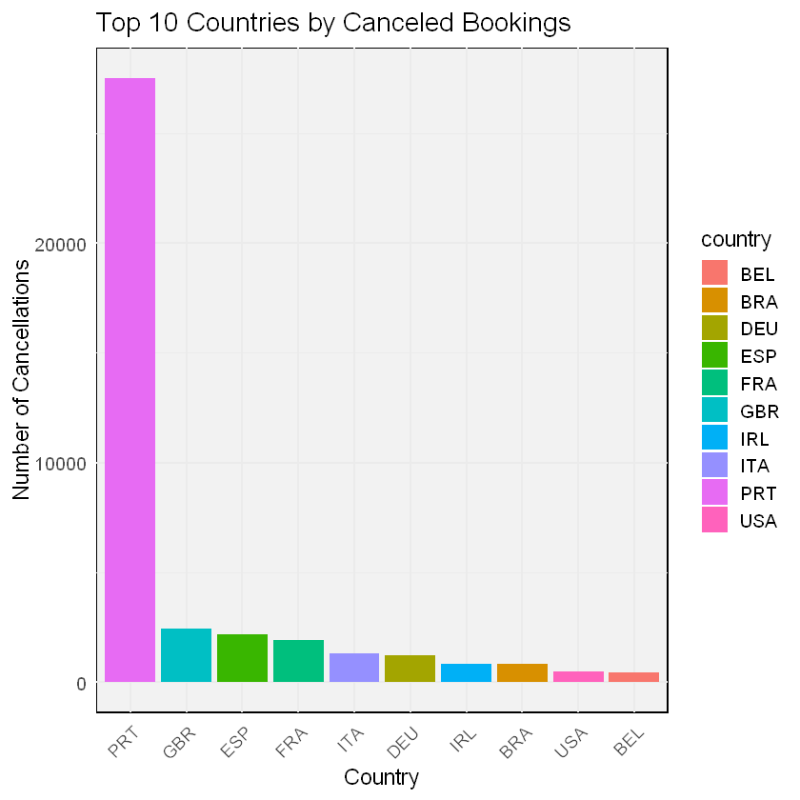


EXPLORATORY DATA ANALYSIS
CANCELLATION RATE DEMOGRAPHICS
The extreme features of the Cancellation Rates among the 178 Countries
Maximum
Cancellation rate
Minimum
Cancellation Rate
100%
0%
Benin[3/3]
Uganda [2/2]
The distinct number of countries represented in the dataset
A ranking of the top ten countries with the highest booking cancellation rates.

Slide 9
RESEARCH QUESTIONS
RESEARCH QUESTION 1
Does the type of hotel (City Hotel vs. Resort Hotel) significantly influence the cancellation rates of bookings for guests?
In which of these Hotel types do we record the highest proportion of cancelled bookings?
This will lead us to perform a Chi Square test to compare the proportions of cancellations across the two types of hotels.
RESEARCH QUESTION 2
What quantitative factors (e.g., lead time, number of special requests, guest type, and booking source) are most influential in predicting whether a hotel booking will be canceled or not (i.e., the likelihood of a booking being canceled)?
We shall apply Logistic Regression in answering this question.
This will help us examine the relationship between quantitative variables and the probability of a booking being canceled, providing a predictive model.

Slide 10
HYPOTHESIS TESTING
HYPOTHESIS 1
Null Hypothesis: There is no significant difference in the cancellation rate between City Hotels and Resort Hotels.
Alternative Hypothesis: There is a significant difference in the cancellation rate between City Hotels and Resort Hotels.

Slide 11
HYPOTHESIS TESTING
CONTIGENCY TABLE
Contingency Table
 | Not Cancelled | Cancelled
City Hotel | 46228 | 33102
Resort Hotel | 28938 | 11122
CHI SQUARE TEST RESULTS
X-squared | 2224.9
Degrees of freedom | 1
P-value | <2.2e-16
Conclusion:
The cancellation proportions or cancellation rates between the two types of hotels, namely City Hotels and Resort Hotels are significantly different.

Slide 12
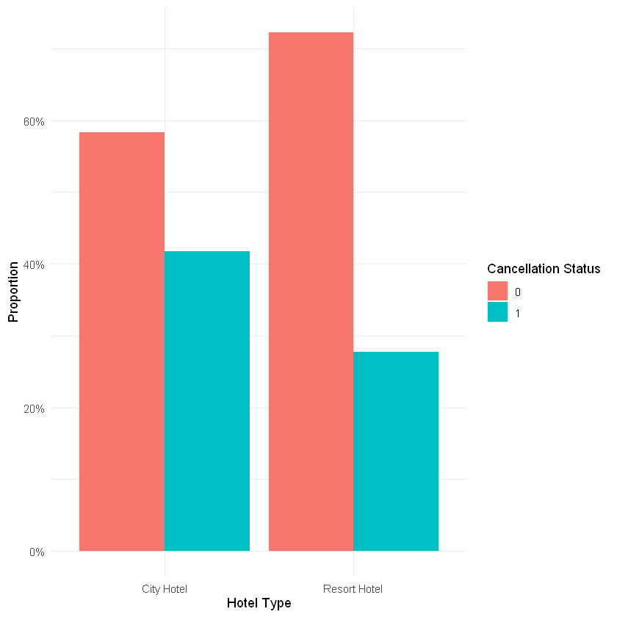
HYPOTHESIS TESTING
VISUALIZING CANCELLATION PROPORTIONS
AMONG THE HOTEL TYPES
The proportion of bookings that are cancelled is significantly higher in City Hotels than Resort Hotel.

Slide 13
HYPOTHESIS TESTING
HYPOTHESIS 2
Null Hypothesis: None of the factors (lead time, number of special requests, guest type, booking source, and their interactions) significantly influence the likelihood of a booking being canceled. Furthermore, no non-linear effects exist.
Alternative Hypothesis: At least one of the factors, including their interactions and/or non-linear effects, significantly influences the likelihood of a booking being canceled.

Slide 14
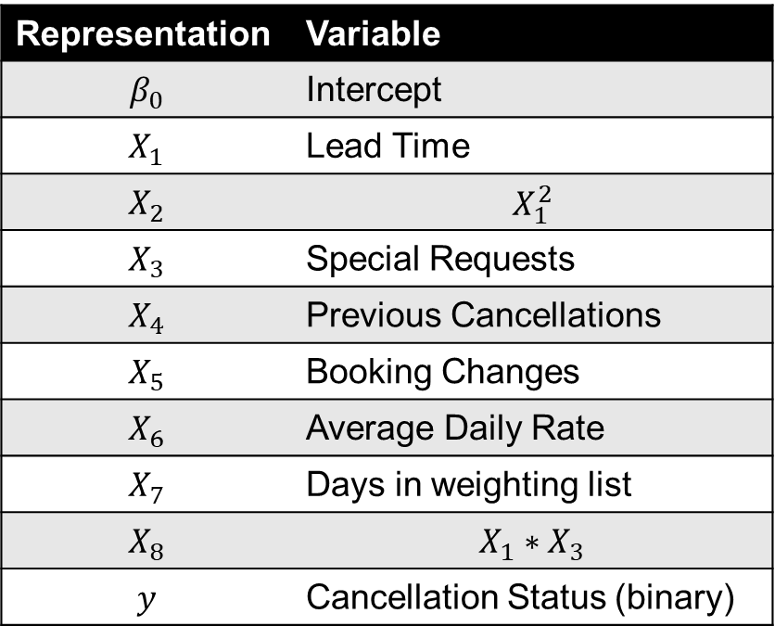

HYPOTHESIS TESTING
FITTED LOGISTIC MODEL
Representation | Variable
$$β_{0}$$ | Intercept
$$X_{1}$$ | Lead Time
$$X_{2}$$ | $$X_{1}^{2}$$
$$X_{3}$$ | Special Requests
$$X_{4}$$ | Previous Cancellations
$$X_{5}$$ | Booking Changes
$$X_{6}$$ | Average Daily Rate
$$X_{7}$$ | Days in weighting list
$$X_{8}$$ | $$X_{1}∗X_{3}$$
$$y$$ | Cancellation Status (binary)
The fitted Logistic regression model is
$$y=β_{0}+\sum_{i=1}^{8}{{β_{i}X}_{i}}$$

Slide 15
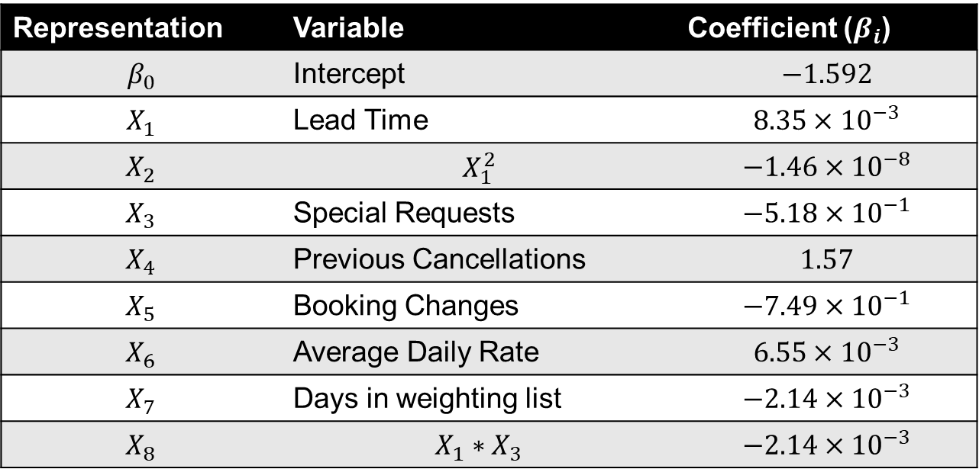
HYPOTHESIS TESTING
FITTED LOGISTIC MODEL
Representation | Variable | Coefficient ($β_{i}$)
$$β_{0}$$ | Intercept | $$−1.592$$
$$X_{1}$$ | Lead Time | $$8.35×{10}^{−3}$$
$$X_{2}$$ | $$X_{1}^{2}$$ | $$−1.46×{10}^{−8}$$
$$X_{3}$$ | Special Requests | $$−5.18×{10}^{−1}$$
$$X_{4}$$ | Previous Cancellations | $$1.57$$
$$X_{5}$$ | Booking Changes | $$−7.49×{10}^{−1}$$
$$X_{6}$$ | Average Daily Rate | $$6.55×{10}^{−3}$$
$$X_{7}$$ | Days in weighting list | $$−2.14×{10}^{−3}$$
$$X_{8}$$ | $$X_{1}∗X_{3}$$ | $$−2.14×{10}^{−3}$$

Slide 16
HYPOTHESIS TESTING
GOODNESS OF FIT
Pseudo R-squared | 0.161769
Predictive Accuracy | 0.7252
No Information Rate | 0.6296
We admit that our model might not be the best possible fit. However, it does provide useful insights into the relationships between the quantitative variables and the likelihood of a customer canceling a booking.
This helps answer our hypothesis question and adds to our understanding of the factors influencing cancellations.
The logistic regression analysis shows that the quantitative variables in our dataset (e.g., lead time, special requests, booking changes, etc.) have a statistically significant effect on the likelihood of hotel booking cancellations.

Slide 17
ANALYSING MISSING VALUE EFFECTS
HOW MCAR AND MNAR MISSING VALUES AFFECT OUR ANALYSIS
Missing Completely at Random (MCAR) Values
Missing Not at Random (MNAR) Values
MCAR (Missing Completely at Random) occurs when the probability of missingness is independent of any data, leading to no systematic bias.
In contrast, MNAR (Missing Not at Random) arises when the missingness is related to the unobserved values themselves, potentially introducing bias into the analysis
We simulated MCAR and MNAR for the following variables:
Cancellation Status
Lead Time
Total Number of Special Requests
Average Daily Rates
We handles MCAR by ignoring missing values, while we performed imputation and filling in in dealing with the MNAR cells.

Slide 18
ANALYSING MISSING VALUE EFFECTS
HOW MCAR AND MNAR MISSING VALUES AFFECT OUR ANALYSIS
Effect of MCAR and MNAR Values on the Chi Square Test
 | Before Missing Values | After MCAR | After MNAR
X-squared | 2224.9 | 1577.5 | 2224.9
Degrees of freedom | 1 | 2 | 1
P-value | <2.2e-16 | < 2.2e-16 | < 2.2e-16
With MCAR, the test statistic value drops massively, showing a reduction in the effectiveness of the test in finding the difference in proportions of canceled bookings between the hotel types.
With MNAR, the test statistics remains almost the same due to imputation.
Statistical inference does not change in any of the scenarios.

Slide 19
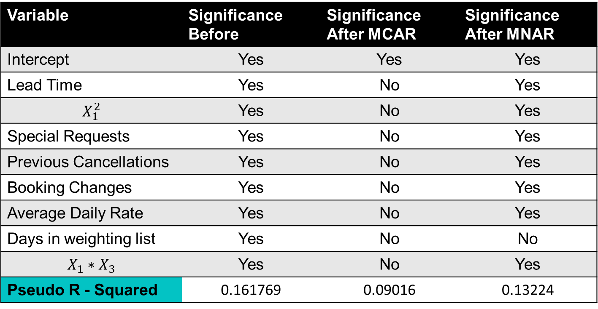
ANALYSING MISSING VALUE EFFECTS
HOW MCAR AND MNAR MISSING VALUES AFFECT OUR ANALYSIS
Effect of MCAR and MNAR Values on the Logistic Regression
Variable | Significance Before | Significance After MCAR | Significance After MNAR
Intercept | Yes | Yes | Yes
Lead Time | Yes | No | Yes
$$X_{1}^{2}$$ | Yes | No | Yes
Special Requests | Yes | No | Yes
Previous Cancellations | Yes | No | Yes
Booking Changes | Yes | No | Yes
Average Daily Rate | Yes | No | Yes
Days in weighting list | Yes | No | No
$$X_{1}∗X_{3}$$ | Yes | No | Yes
Pseudo R - Squared | 0.161769 | 0.09016 | 0.13224

Slide 20
ANALYSING MISSING VALUE EFFECTS
HOW MCAR AND MNAR MISSING VALUES AFFECT OUR ANALYSIS
Effect of MCAR and MNAR Values on the Logistic Regression
After simulating MCAR for the variables, we see that all the variables in the model lose their significance in the logistic regression model. This means the model can no longer explain the likelihood of a booking being canceled.
In relation to our hypothesis, we would fail to reject the null hypothesis, meaning we can't conclude that any of the variables significantly affect cancellations.
With MNAR, We realize that most of the model variable maintain their significance. However, one variable days_in_waiting_list reduces in significance. Also, the McFadden's R^2 reduces, suggesting that the model's efficacy in explaining the booking cancelations has reduced.
Statistical inference changes with the introduction of MCAR but remains unchanged with MNAR.

Slide 21

THANK YOU

